Slide 1
CLAREMONT WEBSITE REVIEW
OCT
2026

Slide 2
PAGES
https://cim-staging.au/websites/claremont/
https://cim-staging.au/websites/claremont/welcome.html
https://cim-staging.au/websites/claremont/preparatory-program.html
https://cim-staging.au/websites/claremont/k-6-primary.html
https://cim-staging.au/websites/claremont/extra-curricular.html
https://cim-staging.au/websites/claremont/enrolment.html
https://cim-staging.au/websites/claremont/policies.html
https://cim-staging.au/websites/claremont/news.html
https://cim-staging.au/websites/claremont/news-article.html
https://cim-staging.au/websites/claremont/contact-us.html

Slide 3
First things, first.
I just wanted to say, it is quite refreshing to receive a first build that is this excellent. You have added animation that just works and nailed so much of the design translation, even across various breakpoints, thank you.

Slide 4
CHECKS COMPLETED
Nav, quick nav, footer and search on Desktop through Mobile.
Homepage Desktop through Mobile.
Welcome Desktop through Mobile.
Preparatory program Desktop through Mobile.
K6 Primary Desktop through Mobile.
Extra-curricular Desktop through Mobile.
Enrolment Desktop through Mobile.
Policies Desktop through Mobile.
News Desktop through Mobile.
News Article Desktop through Mobile.
Contact Us Desktop through Mobile.

Slide 5
Homepage

Slide 6

HOMEPAGE

Slide 7

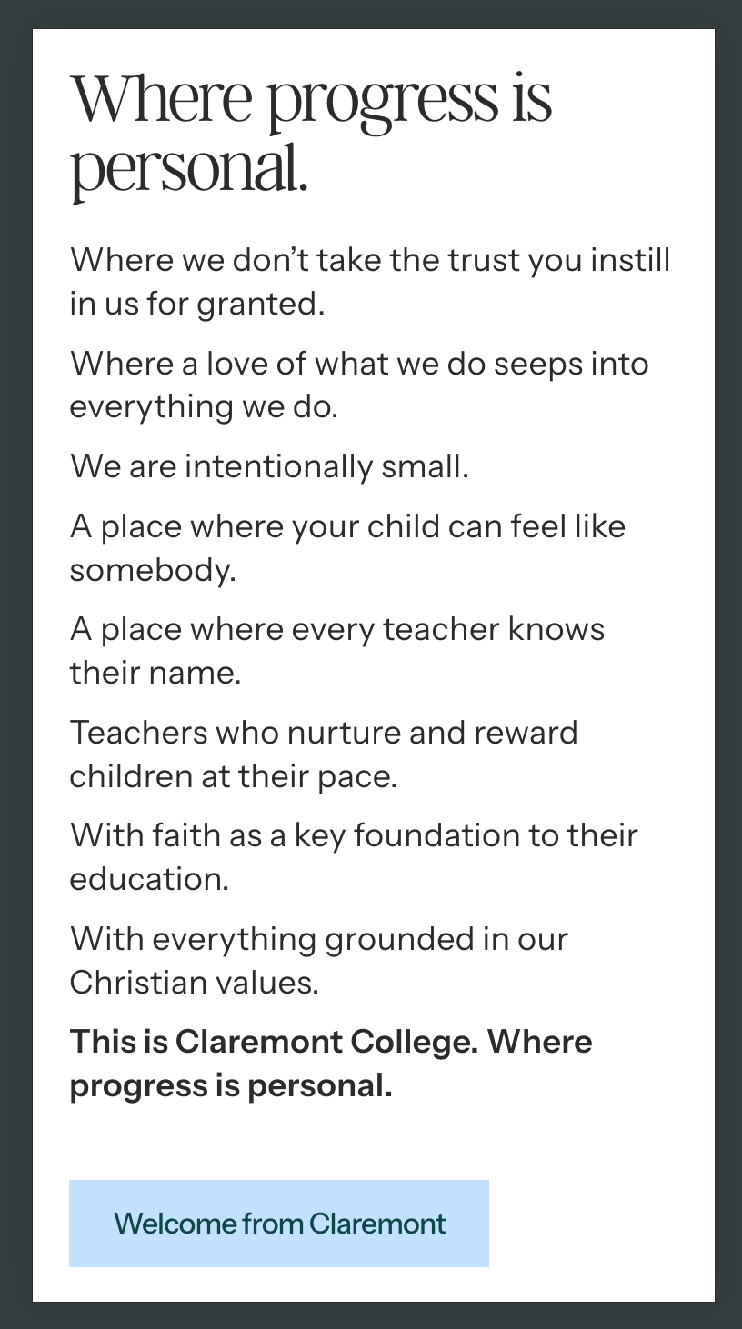
HOMEPAGE

Slide 8
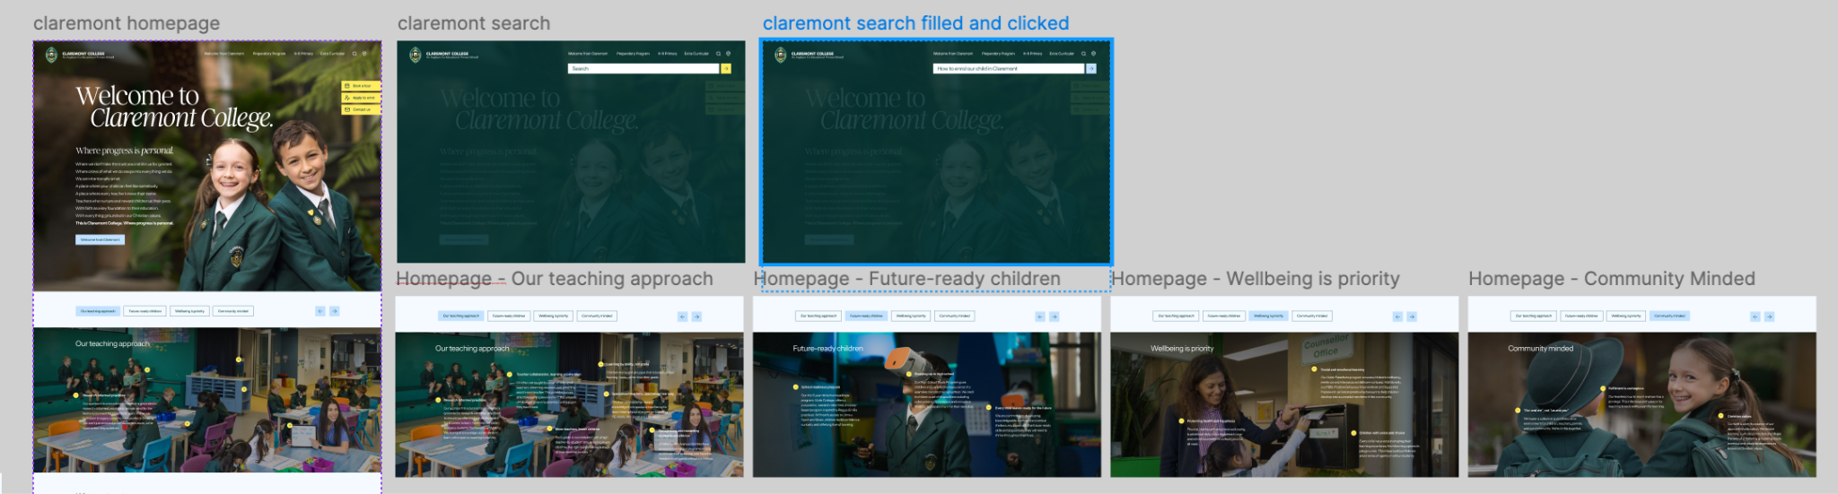

HOMEPAGE

Slide 9
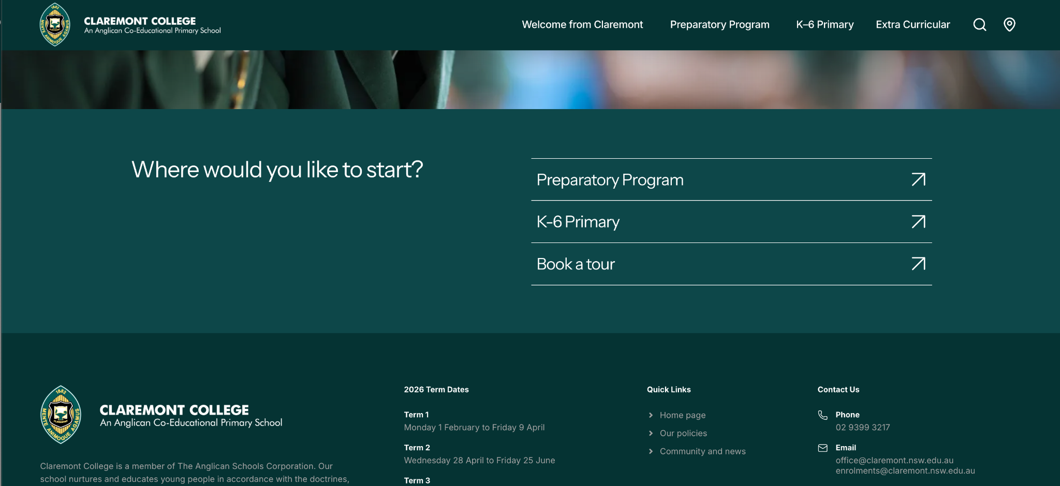
HOMEPAGE

Slide 10
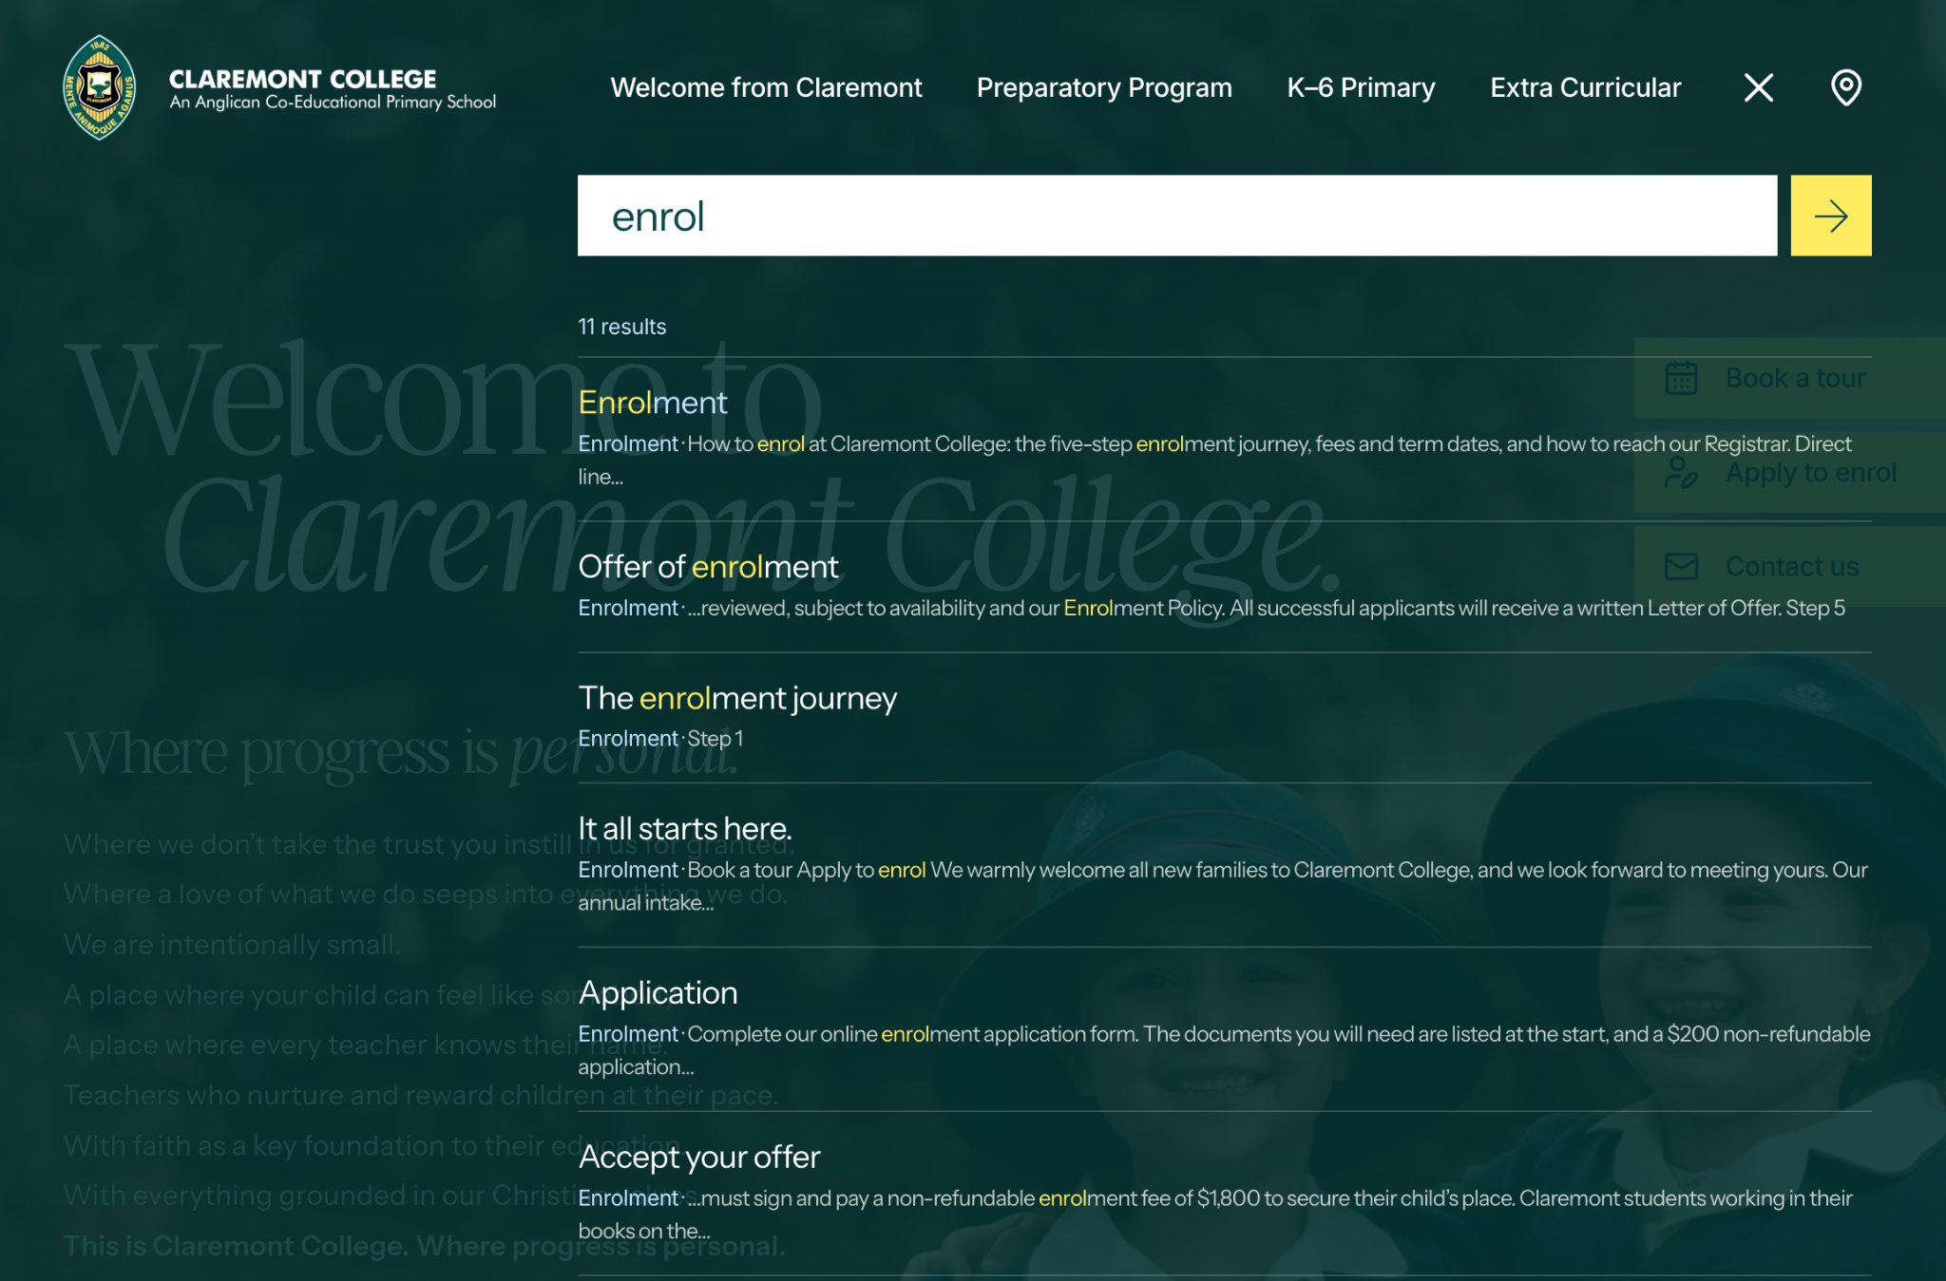
HOMEPAGE

Slide 11
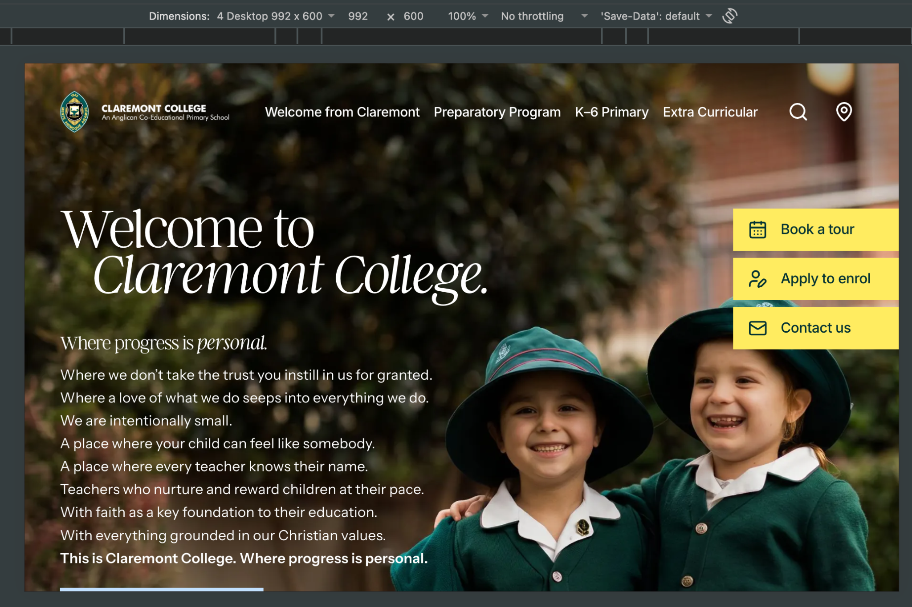
HOMEPAGE

Slide 12

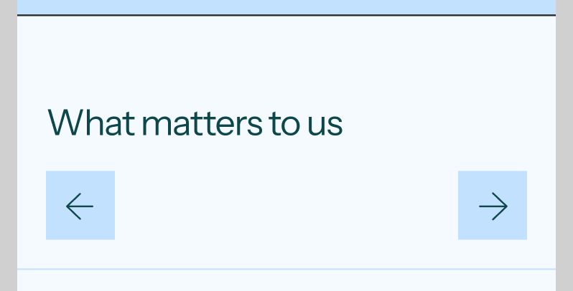
HOMEPAGE

Slide 13

HOMEPAGE

Slide 14
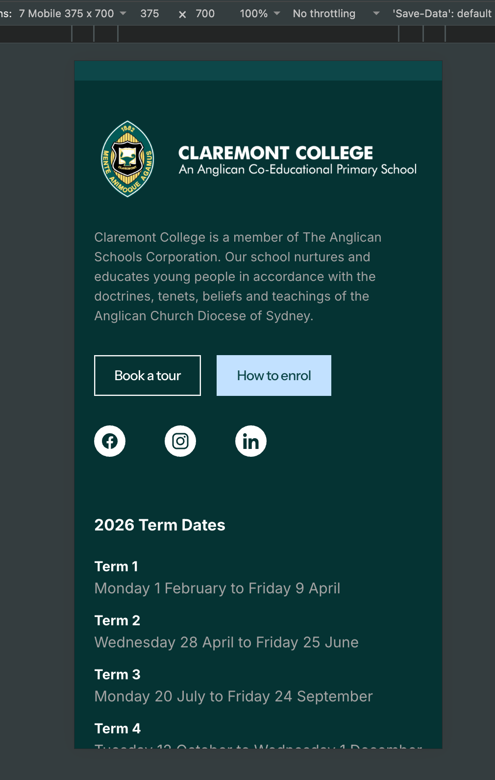
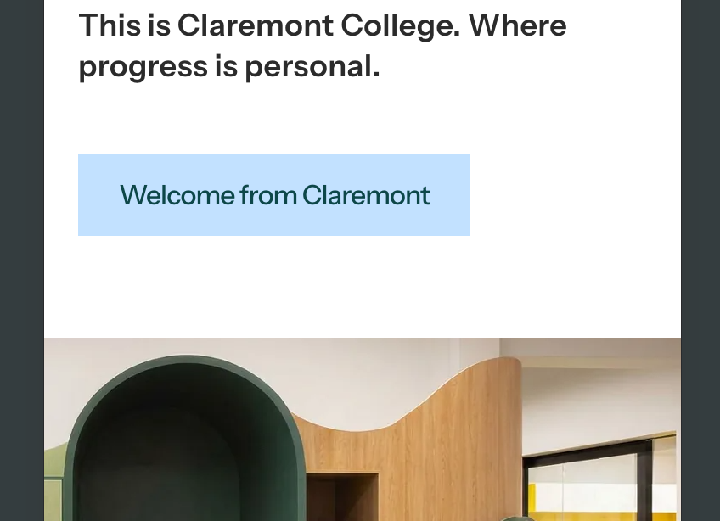
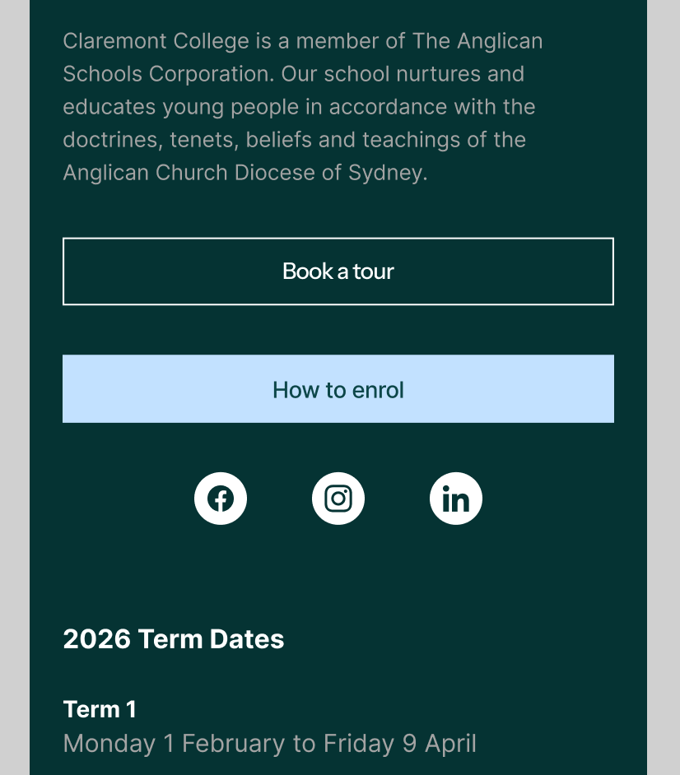
HOMEPAGE

Slide 15
HOMEPAGE

Slide 16
Welcome

Slide 17

HOMEPAGE

Slide 18
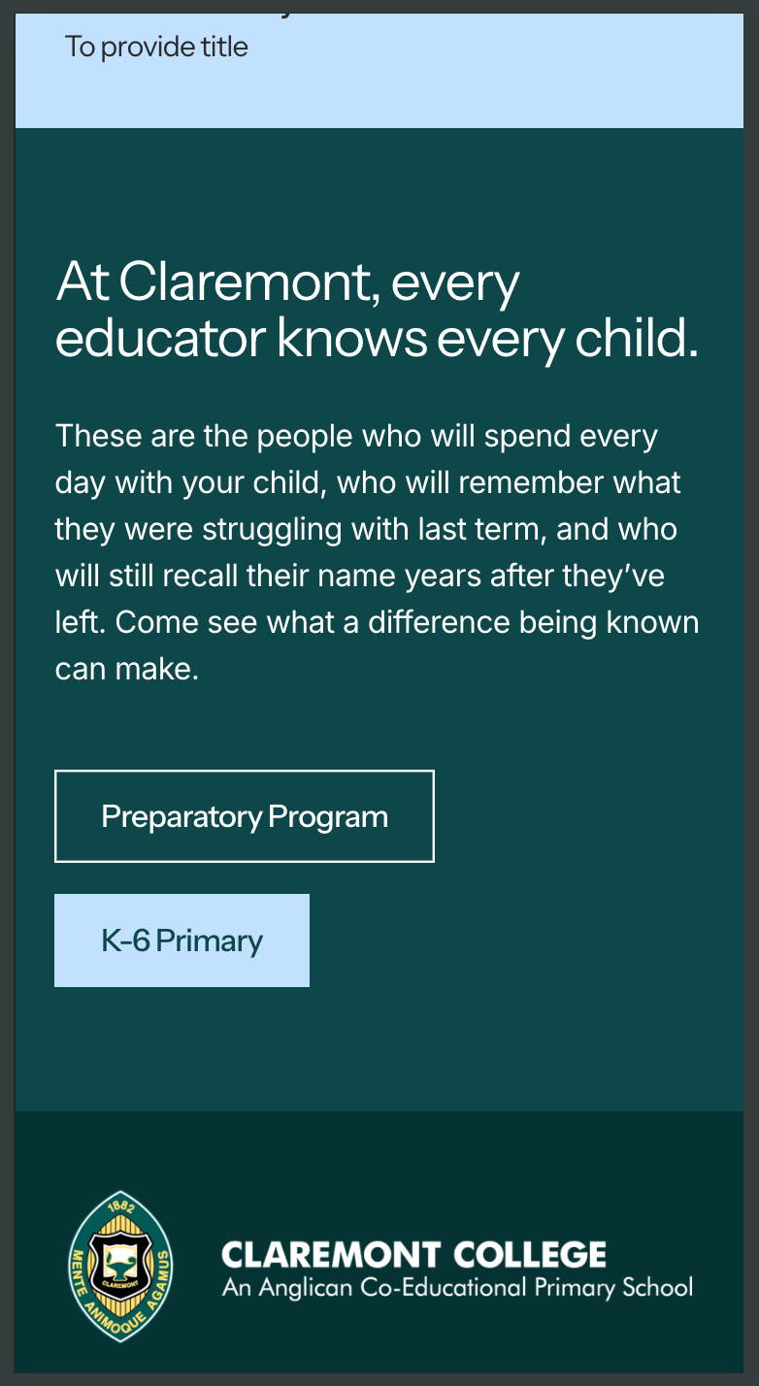
WELCOME

Slide 19
Preparatory program

Slide 20
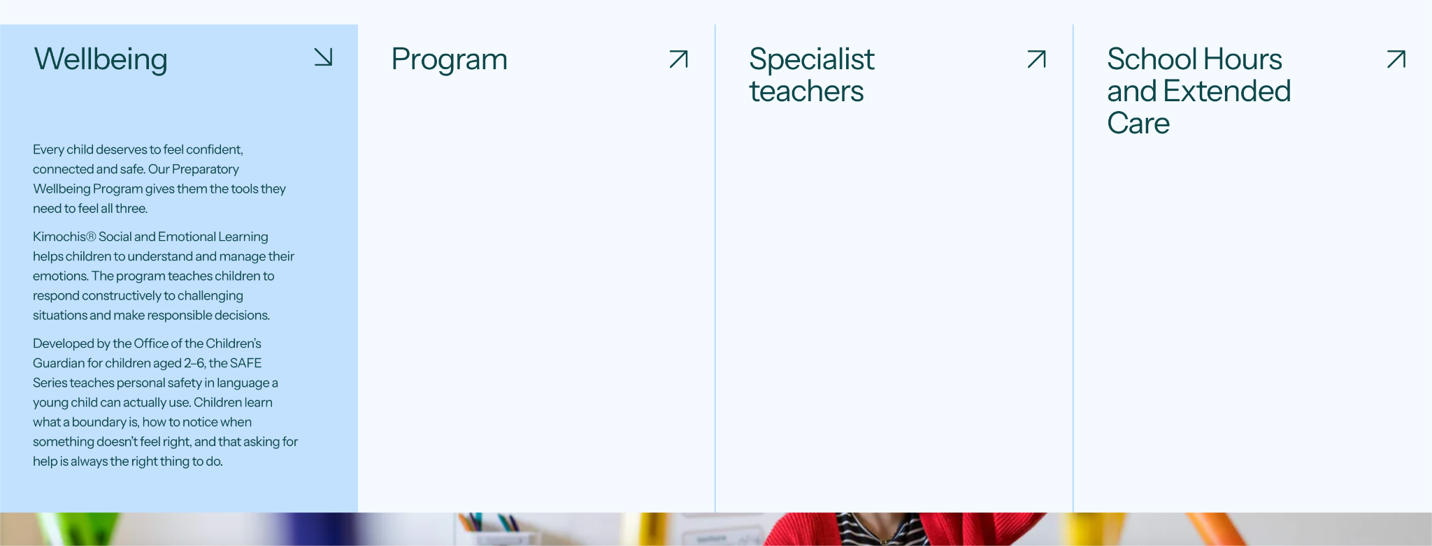
PREPARATORY PROGRAM

Slide 21

PREPARATORY PROGRAM

Slide 22

PREPARATORY PROGRAM

Slide 23
K6 Primary

Slide 24


K6 PRIMARY

Slide 25


K6 PRIMARY

Slide 26

K6 PRIMARY

Slide 27
Extra curricular

Slide 28
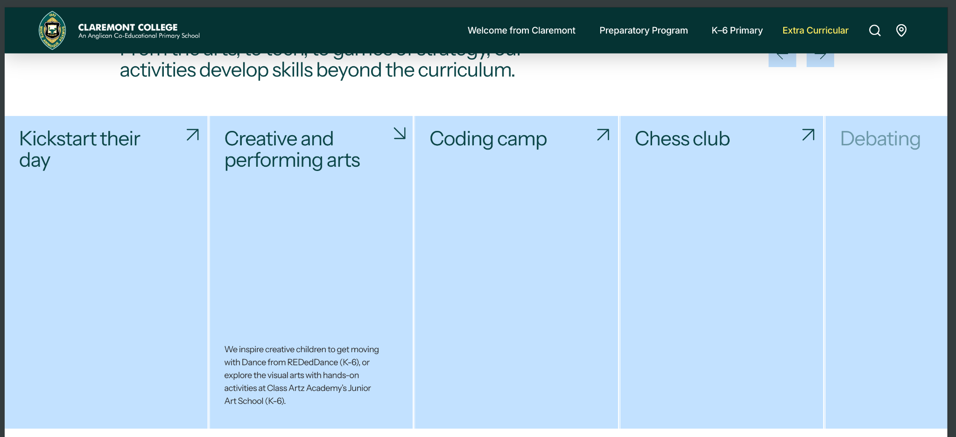
EXTRA CURRICULAR

Slide 29

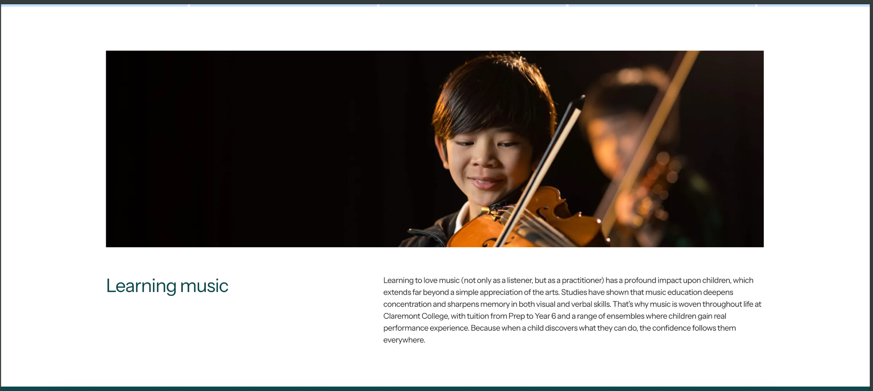
EXTRA CURRICULAR

Slide 30


EXTRA CURRICULAR

Slide 31
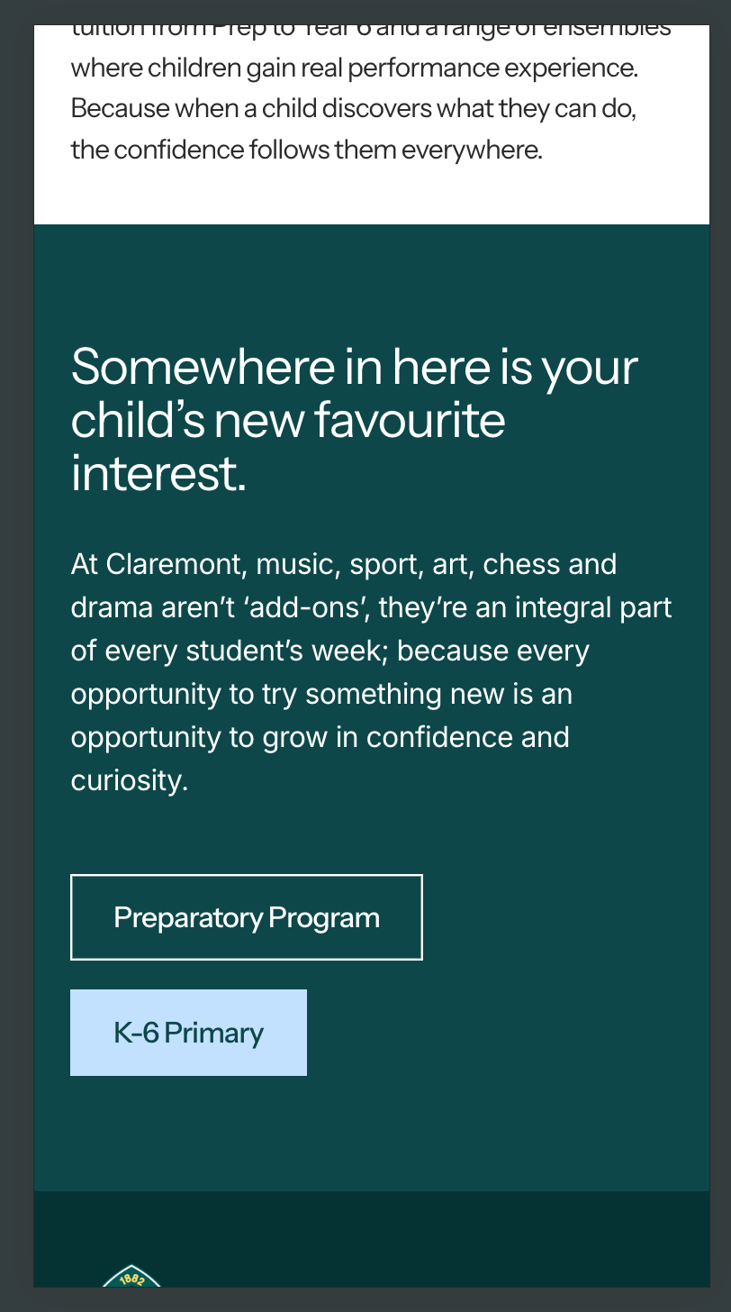
EXTRA CURRICULAR

Slide 32
Enrolment

Slide 33
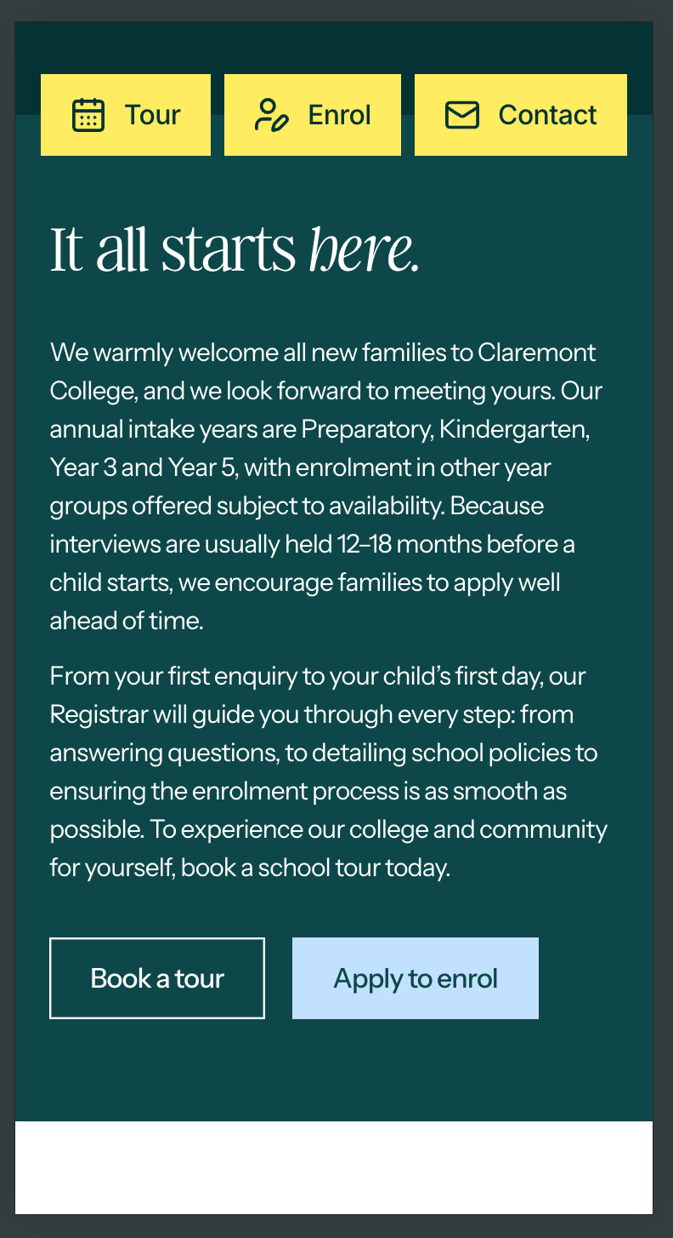
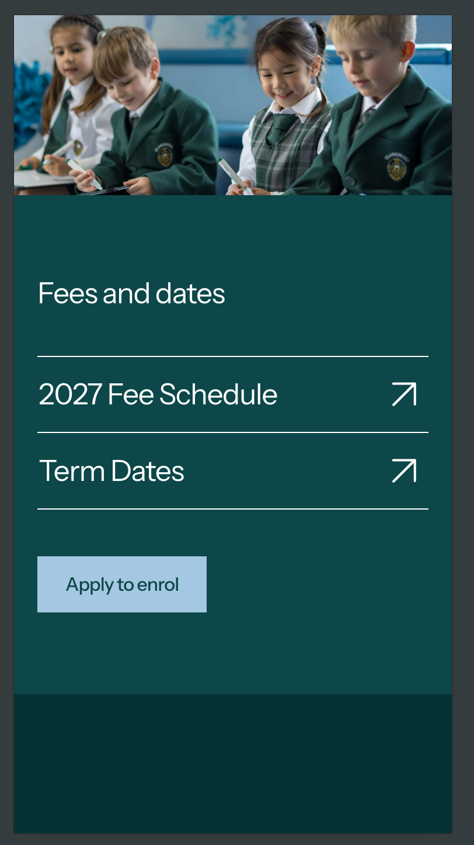
ENROLMENT

Slide 34
Policies

Slide 35

POLICIES

Slide 36

POLICIES

Slide 37
News

Slide 38
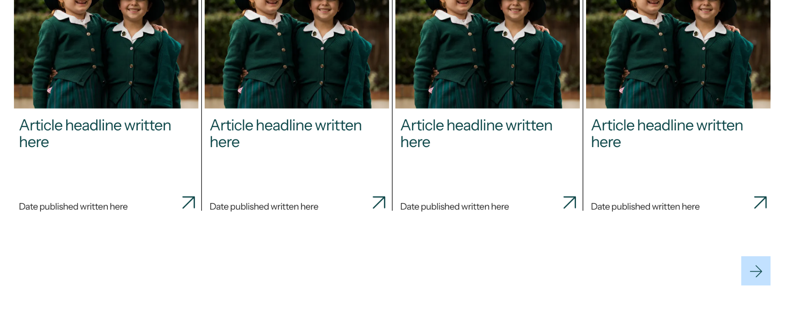
NEWS

Slide 39
News Article

Slide 40
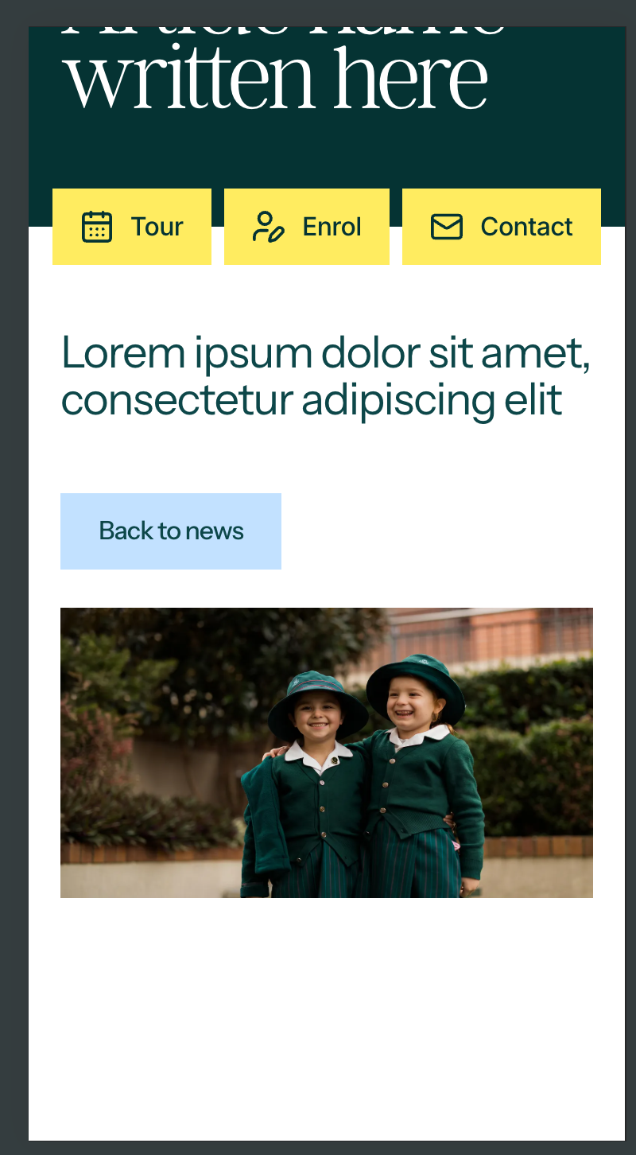
NEWS ARTICLE

Slide 41
NEWS ARTICLE

Slide 42
Contact Us

Slide 43
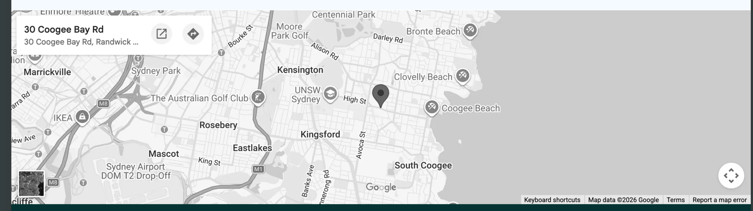
CONTACT US

Slide 44
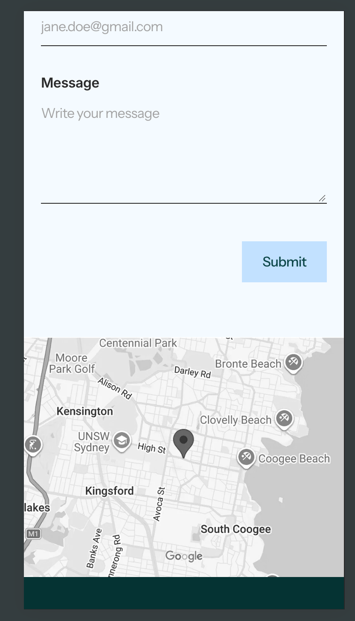
CONTACT US

Slide 46
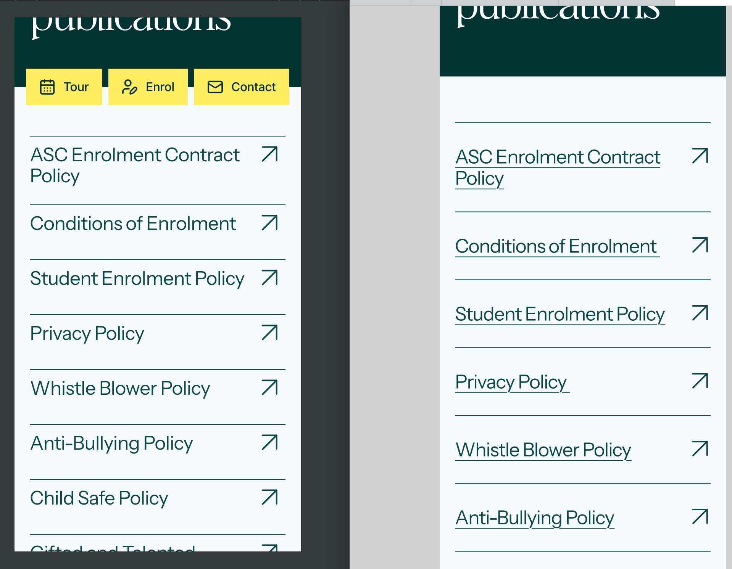
POLICIES

